Slide 1
Bike Sharing Demand Analysis Project Using Excel

Slide 2
Steps to clean the Data sets
Removed the duplicate and sort the date and give the formula for weekdays from numbers to weekday and weekend
Change the Holiday status based on the weekday and weekend.
Changed the weathers as well based on numbers.
Same thing has been done for Data set 2 and Data set 3
Later Merged data set 1 and Data set 2 removed the duplicated
Append: Marged data with Data set 3, got the final data to analysis
In Final Data : added pivots, forecasting and dash boards

Slide 3
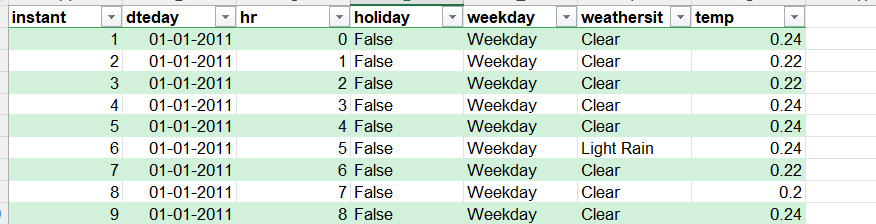
Highlighted top 10 counts using condition formatting
And added the bar to the registered numbers, and the highest registered numbers are 247 on weekdays when the weather was clear dated 20th Jan
Using IF statement classified week ends and weekdays based on the number from 0 to 6
And provided the Holiday column updated.
Pivot chats
Based on the weekend and weekdays registration: to find out whether we are getting more
Trials and registration is on week days or weekends.
Based on the below pivot we have more registration on weekdays only.

Slide 4
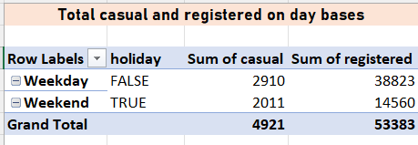
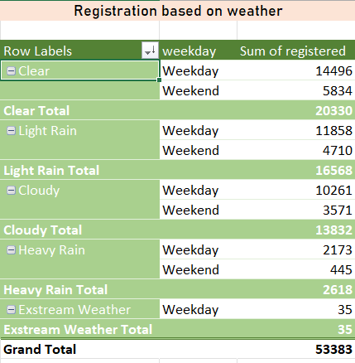
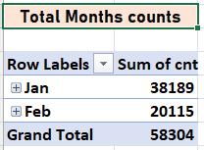
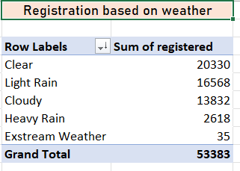
Registration based on weather : we have more on clear weather on weekdays
Based on moths we have more count in Jan.

Slide 5
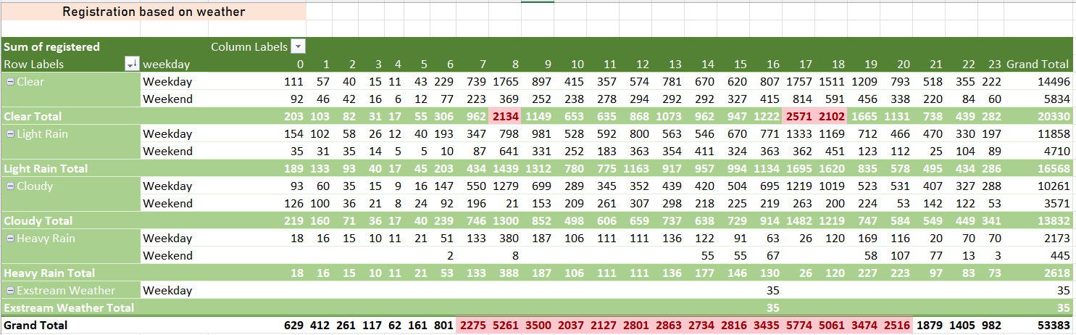
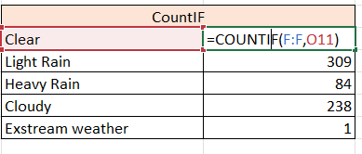
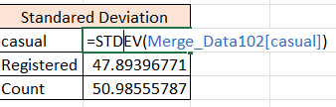
Registration more than 2000 on day bases and weather bases
COUNTIF formula
STDEV formula to calculate standard Deviation

Slide 6
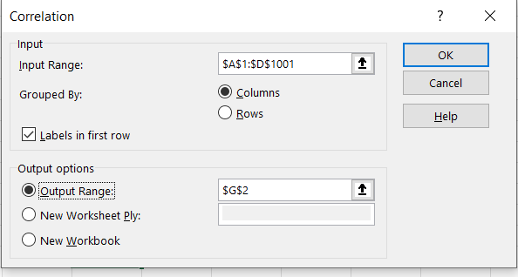
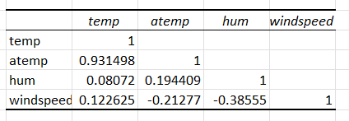
CORREL : Correlation between the date set: temp to weather Date > Data Analysis > Correlation > select the range of date where u want to correlate and then click on Labels in first row and then select the Output range > OK

Slide 7
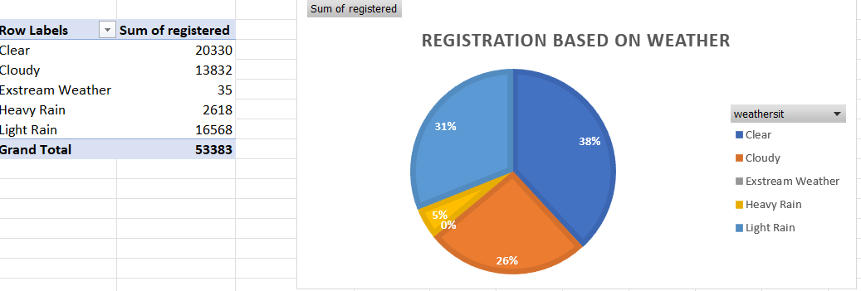
Data Visualization & Business Intelligence- Dynamic Dashboard Put pivot based on Month, weather, Temp and registration details

Slide 8
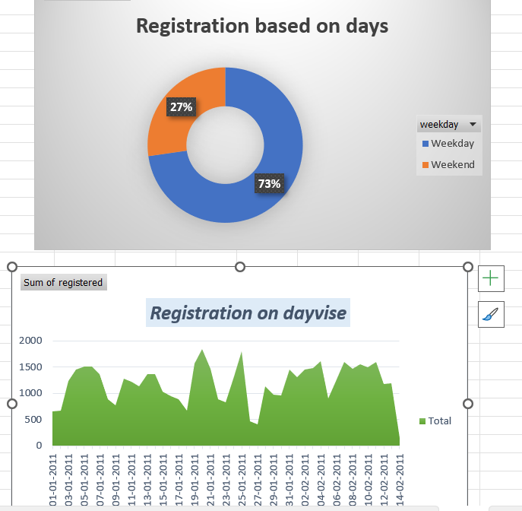

Slide 9
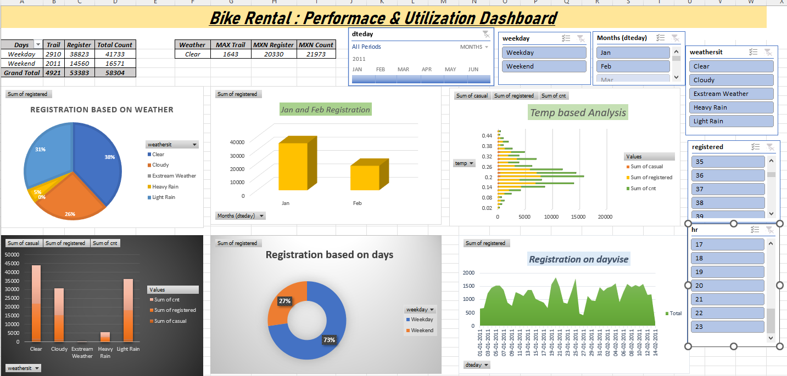
Later everything moved on one sheet below the screenshot

Slide 10
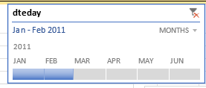
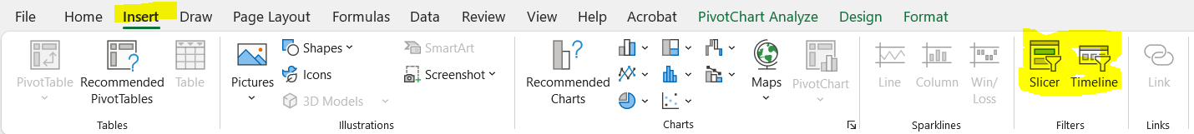
Created timeline : timeline can be create only on time, date As we have dates only for Jan and Feb so selected only those 2 months.
Created slice : click on any of chat > insert > slicer > select the column for which u want to create slicer .
For Timeline and slicer reference.

Slide 11
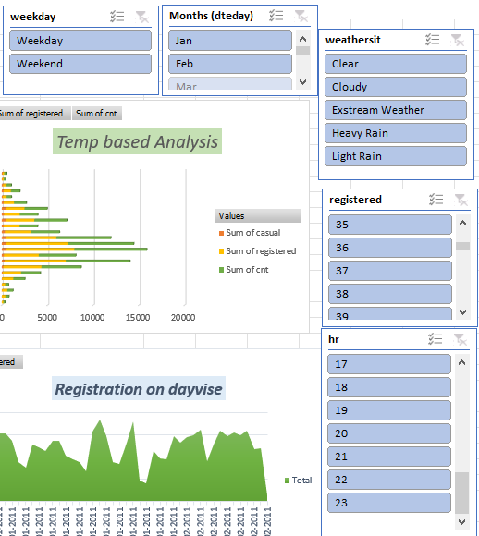
Connecting the slicer with each other so that we can get the detailed analysis based on selected period.
Example : right click on slicer > select Report connections > select the pivots which ever u want to inter connect > okay
Later once u select anything from one slicer it will reflect to rest of the chats and show the details

